Slide 1



The total count of records from the Udemy data.
View in Power BI
Last data refresh:
09/11/2021 17:39:18 UTC
Downloaded at:
09/11/2021 18:04:54 UTC

Slide 2
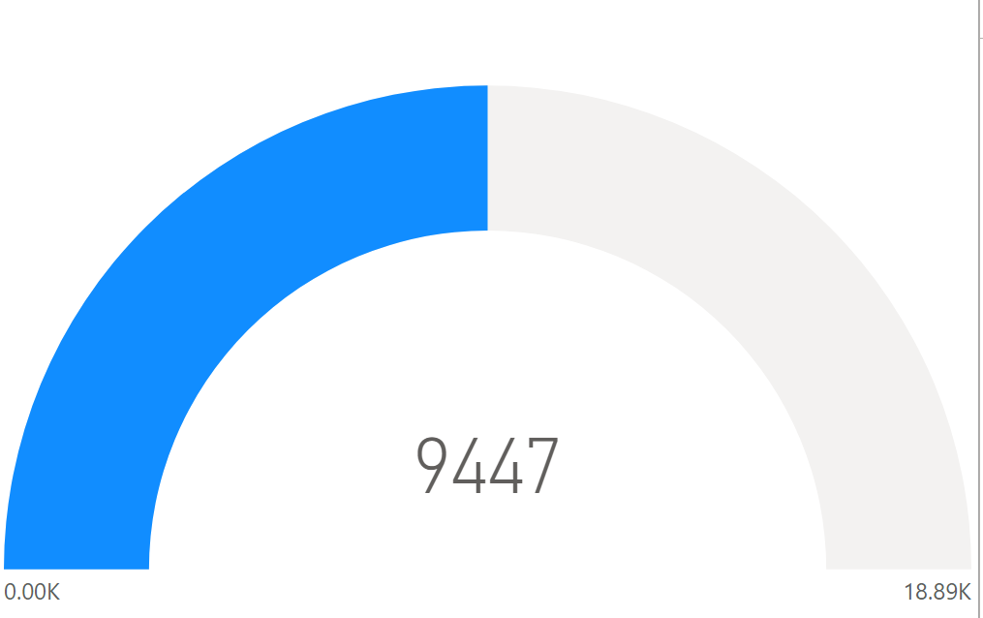
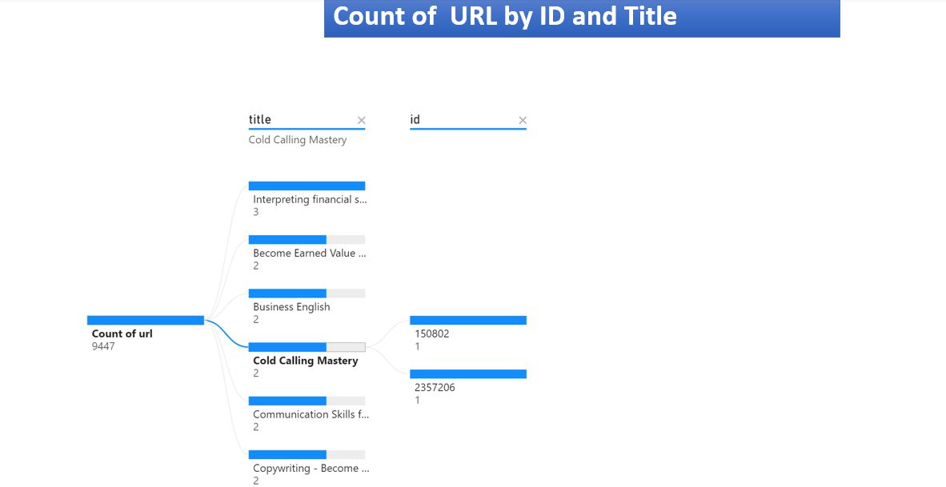

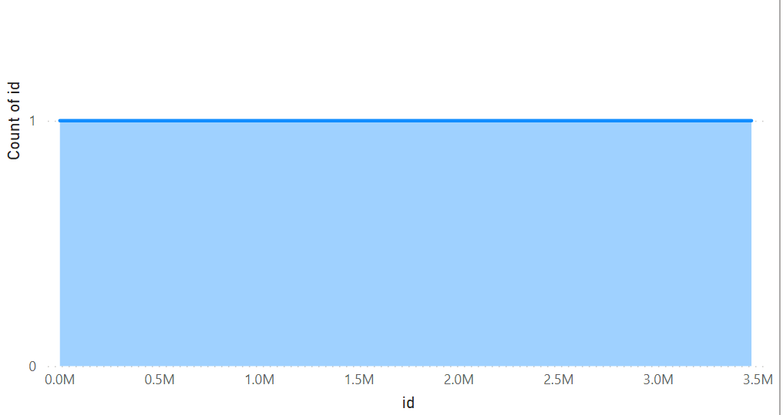
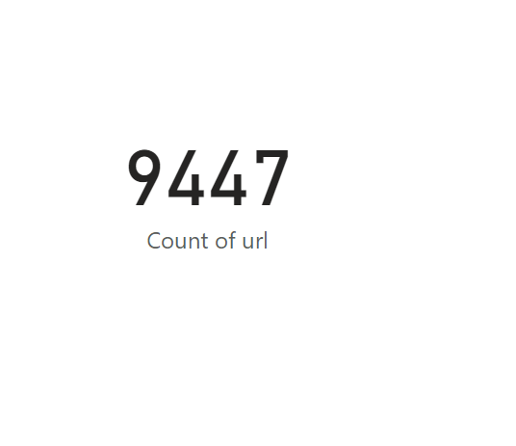
Page 1
The visuals on this dashboard are representing the total count of records regarding the data from 10 k Udemy courses on business category.
The card visual on the top left corner is showing the total count of URL of the total courses,, which is 9447. The URL contains unique value for each record.
Just below that, is the gauge visual representing the total count of ID , which is 9447 too. IDs are also the unique values of the data given.
Th visual on the top , is the area chart representing the values of the IDs in million. The largest value of an ID is, approximately 3.5 million .
Each decomposition tree maps represent the total count of records via two unique values the ID and the URL, which are both 9447.
Notes:
The above de

